Slide 1
Md. Abdul Malek Assistant Professor, Dept. of Electrical & Electronic Engineering (EEE) Rajshahi University of Engineering & Technology (RUET)

Slide 2
Homogeneity Property
The homogeneity property states that if the input is multiplied by a constant, then the output(also called the response) is multiplied by the same constant.
For a resistor, Ohm’s law relates the input i to the output v,
If the current is increased by a constant k, then the voltage increases correspondingly by k; that is,

Slide 3
Additivity Property
The additivity property requires that the response to a sum of inputs is the sum of the responses to each input applied separately.
If i₁ ampere current separately applied to the resister then output voltage is
If i₂ ampere current separately applied to the resister then output voltage is

Slide 4
Additivity Property
If (i₁+i₂) ampere current applied to the resister then output voltage is

Slide 5
Linearity Property
The linearity property is a combination of both the homogeneity property and the additivity property.
A circuit is linear if it has both additive and homogeneous property.
A linear circuit consists of only linear elements, linear dependent sources, and independent sources.
A linear circuit is one whose output is linearly related (or directly proportional) to its input.
A resistor is a linear element because the voltage-current relationship satisfies both the homogeneity and the additivity properties.

Slide 6
Linearity Property
Relationship between power and voltage (or current) is nonlinear.

Slide 7
Superposition Theorem
The superposition principle states that the voltage across (or current through) an element in a linear circuit is the algebraic sum of the voltages across (or currents through) that element due to each independent source acting alone.

Slide 8
Superposition Theorem
The principle of superposition helps us to analyze a linear circuit with more than one independent source by calculating the contribution of each independent source separately.
we must keep two things in mind:
1. We consider one independent source at a time while all other independent sources are turned off. This implies that we replace every voltage source by 0 V (or a short circuit), and every current source by 0 A (or an open circuit). This way we obtain a simpler and more manageable circuit.
2. Dependent sources are left intact because they are controlled by circuit variables.

Slide 9
Superposition Theorem
Steps to Apply Superposition Principle:
1. Turn off all independent sources except one source. Find the output (voltage or current) due to that active source using mesh analysis or nodal analysis
2. Repeat step 1 for each of the other independent sources.
3. Find the total contribution by adding algebraically all the contributions due to each the independent sources.

Slide 10
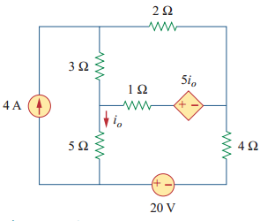
Superposition Theorem
Problem: Find i_{o} in the circuit using superposition.

Slide 11
Superposition Theorem
Solution: Let,
Where i'_{o} and i''_{o} are due to the 4 A current source and 20 V voltage source respectively.

Slide 12
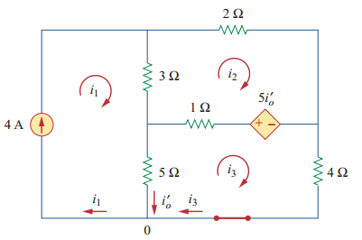
Superposition Theorem
To obtain i'_{o} , we turn off the 20 V source
From mesh 1, we can write
_
+
_
+
_
+
Apply KVL for mesh 2
But

Slide 13
Superposition Theorem
Apply KVL for mesh 3
+
_
_
After solving equation (i) and (ii), we get
+
_
+

Slide 14
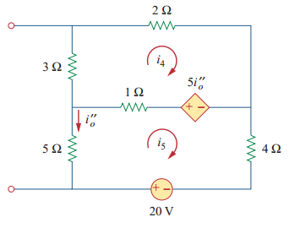
Superposition Theorem
To obtain i''_{o} , we turn off the 4 A source
Apply KVL for mesh 4
_
+
_
+
_
+
But

Slide 15
Superposition Theorem
Apply KVL for mesh 5
_
+
_
+
_
+
_
_
+
+
After solving equation (iii) and (iv), we get
_
+

Slide 16
Superposition Theorem
I_{o} current is

Slide 17
Home Work
Example: 4.3, 4.5
Practice Problem: 4.3, 4.4, 4.5

Slide 18
Thank You

